Slide 1
Lecture 4: Renewable energy sources

Slide 2
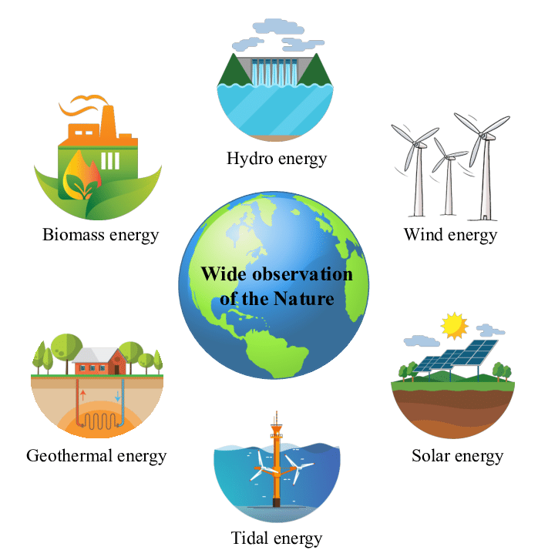
INTRODUCTION TO RENEWABLE ENERGY
Also known as clean energy
Energy derived from natural sources that are replenished at a higher rate than they are consumed.
Examples: Sunlight, wind, water, etc.
Transitioning from fossil fuels, which currently account for the maximum share of emissions, to renewable energy is key to addressing the climate crisis.
RE is booming currently as the system cost has come down with advancement in technology.
RE promises cleaner future for coming generations.

Slide 3
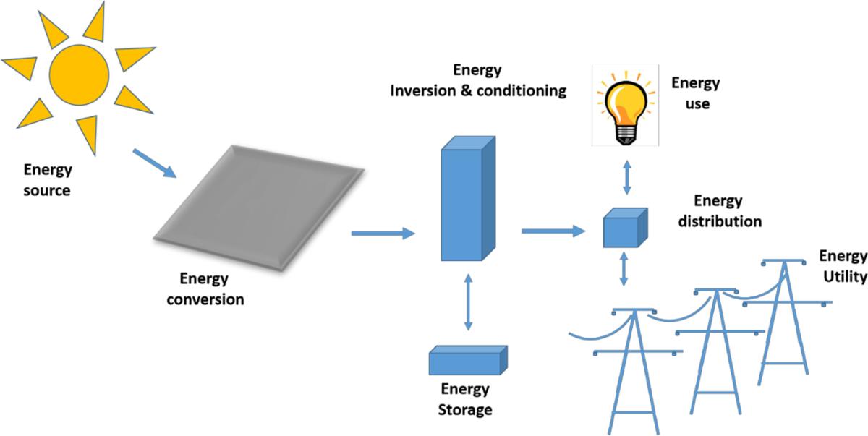
SOLAR ENERGY
Energy received from the
ultimate source , i.e., SUN
This Energy can be in a form of
Heat and Light
Solar energy has been
categorized as :
Solar Thermal
Solar Photovoltaics (SPV)

Slide 4
SOLAR ENERGY (2)
Solar Thermal
Utilizes heat energy from the sun for:
Heating water used in homes,buildings, or swimming pools
Heating the inside of homes, greenhouses, and other buildings; and
Heating fluids high to temperatures in solar thermal power plants for electricity generation
Solar Photovoltaics (SPV)
Convert sunlight into electricity by
a solar PV Panels/Modules
PV Panels are generally made up of
silicon cells

Slide 5
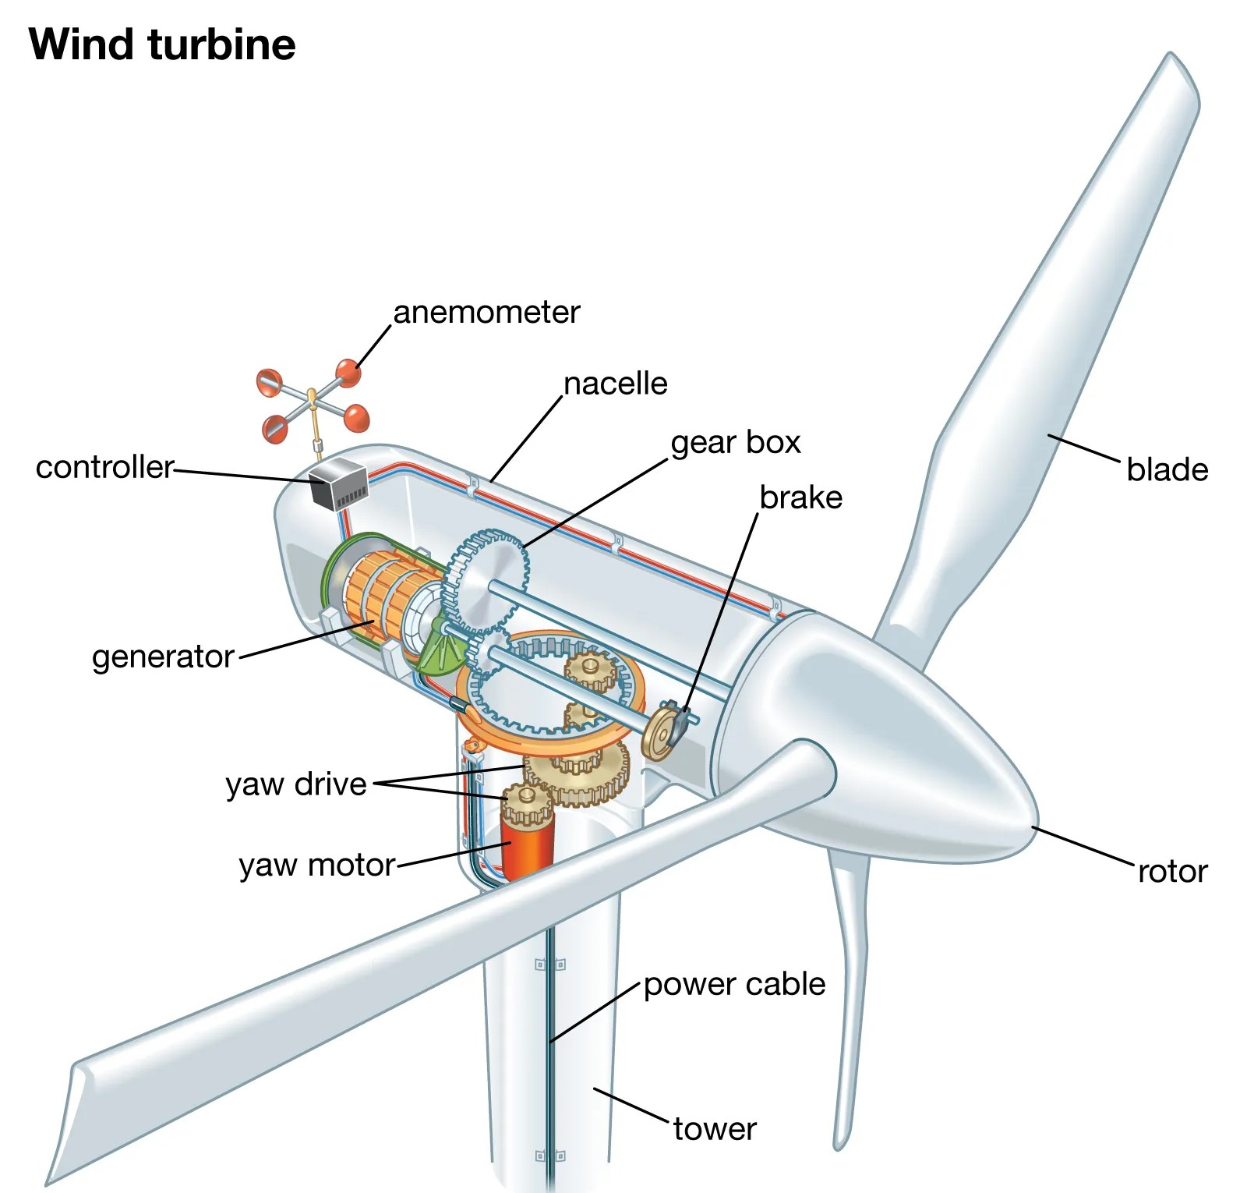
WIND ENERGY
Energy derived from moving air or wind
Wind energy is converted into electrical energy via wind turbine or propeller
The energy in the wind turns propeller-like blades of wind turbine around a rotor. The rotor is connected to the main shaft, which spins a generator to create electricity
Generally wind turbines are installed at a height of 100 feet or above
Source: https://energy.gov/eere/wind

Slide 6
WIND ENERGY (2)
• Advantages of Wind Energy
Clean and renewable source of power
Cost effective
Rapid growth of industry, large potential
• Disadvantages of Wind Energy
Wind reliability
Threat to wildlife
Noise and visual pollution

Slide 7
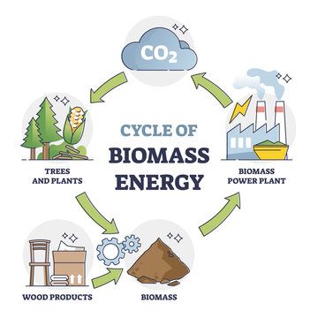
BIO ENERGY
• Energy derived from biomass and biogas sources
• Biomass is a renewable source obtained from plants, micro-organisms and their derivatives
• Biogas can be understood as a fuel Which is generated by breaking of biomass substances by micro-organism in anaerobic environment.
• Commonly used biofuel are Ethanol and Biodiesel

Slide 8
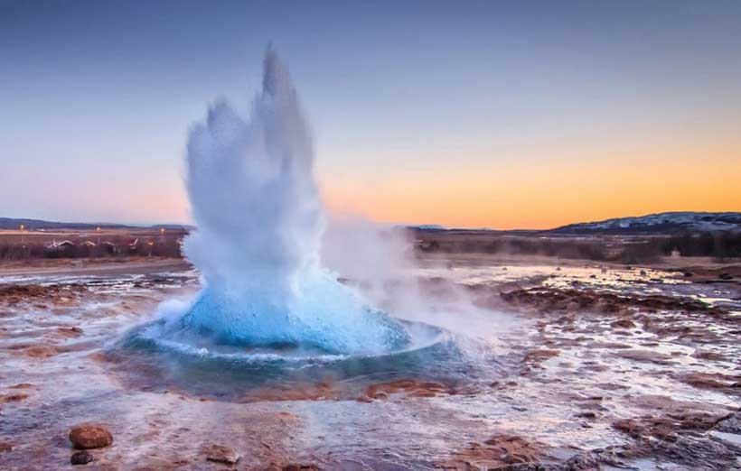
GEOTHERMAL ENERGY
Geothermal is a combination of two words:
Geo = Earth + Thermal = Heat
Geothermal Energy is defined as the energy contained with in the earth
It can be extracted via heat pumps, hot springs and setting up of a power plant in the vicinity of any kind of underground heat reservoir

Slide 9
FEW MORE ENERGY
Tidal Energy
Wave Energy
Hydro Energy
Up-coming Energy Technology
Hydrogen Energy and Fuel cells
Energy Storage

